Slide 1
SwiftUI Architectural Design Patterns

Slide 2
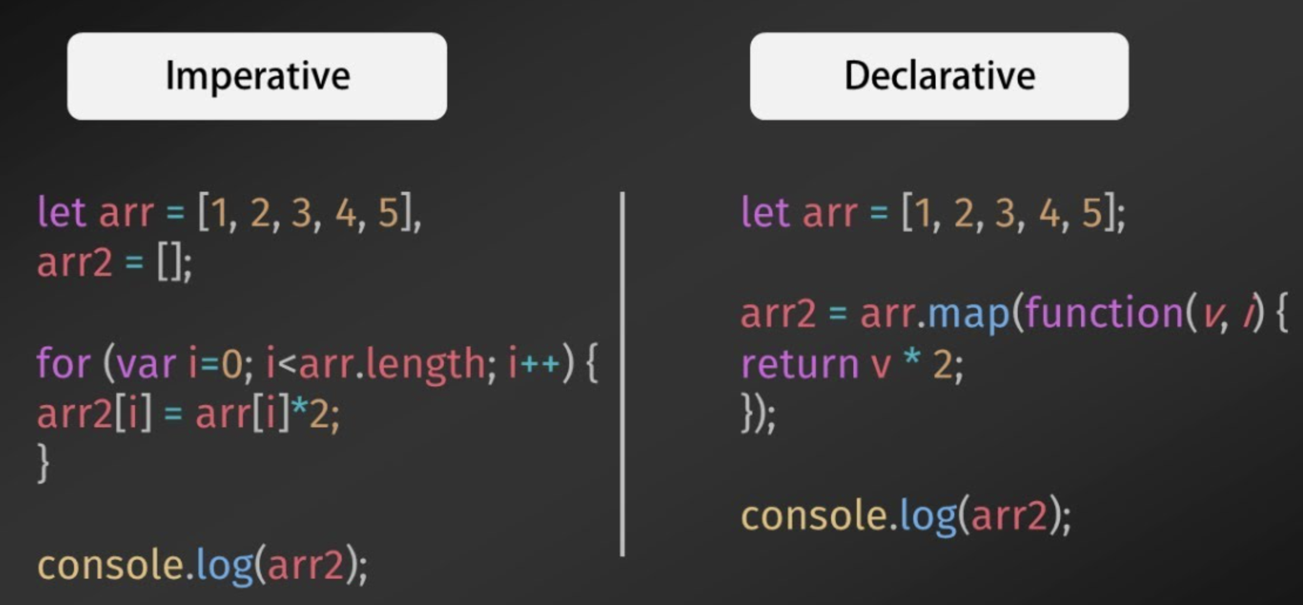
UIKit vs SwiftUI
UIKit was an imperative, event-driven framework.
SwiftUI is a declarative, state-driven framework.

Slide 3
Single Source of Truth
SwiftUI data flow is based on the concept that data has a single source of truth. With a single source of truth, there is one and only one place that determines the value of a piece of data.
Source of truth can be State variable (for state local to the view) or StateObject (for shared data models) to let SwiftUI manage the value or object for you.

Slide 4
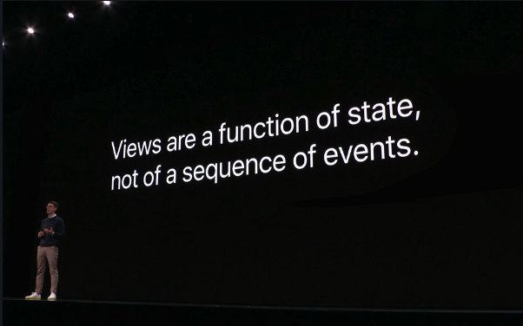

Slide 5
Anti-Architectural Design Patterns in SwiftUI

Slide 6
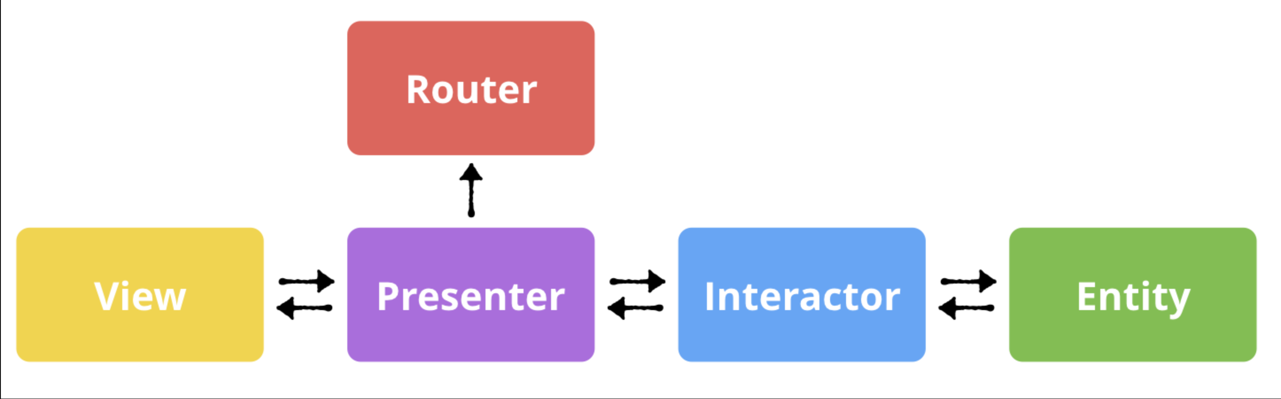
Viper
VIPER is an acronym that stands for View-Interactor-Presenter-Entity-Router.
VIPER is a great software architecture for UIKit.
But it’s not the best architecture for SwiftUI.

Slide 7
What problem does Viper solve?
Seperating the responsibilities into the VIPER modules.
Creating more scalible and testable code.
Easier to maintain the code.

Slide 8
View: The view layer, contains UI logic.
Interactor: We can think of it as “The Network Manager”
Presenter: I like to think of it as the motherboard, it connects all layers together.
Entity: Entities are simply our models that are used by the interactor.
Router: Someone calls it “Wireframe”. This layer is responsible for handling navigation logic.

Slide 9
Why is Viper not suitable for SwiftUI?
There is no view in SwiftUI. In SwiftUI, “Views” are lightweight structs that exist to define our application.
There is no way to create an instance of View on Presenter.
Router is not required.

Slide 10
Coordinator
Coordinator (aka Router) was an essential part of VIPER, RIBs and MVVM-R architectures. Allocation of a separate module for screen navigation was well justified in UIKit apps.
Coordinators aimed to solve two problems:
Decoupling the ViewControllers from each other
Programmatic navigation

Slide 11
Why is Coordinator not suitable for SwiftUI?
Navigation is fully controlled by the state changing.
“Views are a function of state”. The key word here is function. An algorithm of converting state data to a rendered picture.
Routing is an integral part of this drawing algorithm.

Slide 12
MVVM
SwiftUI comes with MVVM built-in.
In the simplest case, where the View does not rely on any external state, its local @State variables take the role of the ViewModel, providing the subscription mechanism (Binding) for refreshing the UI whenever the state changes.
For more complex scenarios, Views can reference an external ObservableObject, which in this case can be a distinct ViewModel.

Slide 13
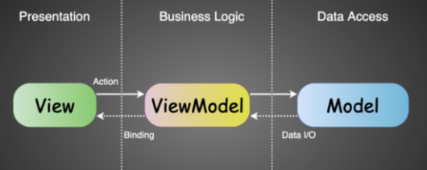
Model: a passive or active data container.
View: View is the usual SwiftUI view, which may be stateless or stateful - it depends on the code style or situation.
ViewModel: an ObservableObject that encapsulates the business logic and allows the View to observe changes of the state

Slide 14
Pros & Cons
Advantages | Disadvanteges
Simple and clear implementation. | Bidirectional architecture: which is not very good for scaling and complex screens.
There are no dependencies between Views. | High modularity - expansion of the code.
Updating the View occurs only as needed which is controlled by the ViewModel. | There is no single source of truth, which is important for the SwiftUI state drive concept.
Simple testability of individual parts of the app.
High modularity: We can reuse that View In multiple places without changing a View’s code itself.

Slide 15
AppState-MVVM architecture
AppState-MVVM — is a modernized MVVM architecture, in which the missing AppState layer appears. It’s kind of a combination MVVM and Clean architectures.
On using and updating AppState the binding is dispatched directly not to the View, but to the ViewModel, which encapsulates business logic inside and in needed form and only if need updates the View.

Slide 16
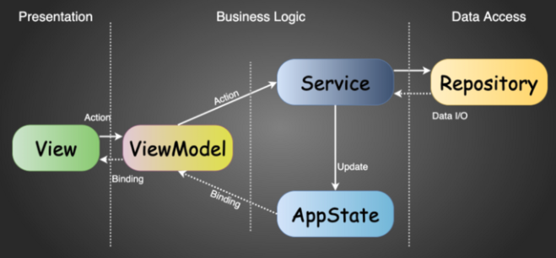
AppState - the single source of truth and keeps the state for the whole app.
Repository is an abstract gateway for data I / O. It is also stateless, doesn’t have write access to the AppState and contains only the logic related to working with the data.
Service provides access to data from Repository layer (e.g., a web server, a local database, etc.) and have write access to the AppState.
ViewModel encapsulates the business logic for the specific View.
View is the usual SwiftUI view, which needs to be stateless because of the presence of the AppState and the ViewModel layers.

Slide 17
Pros & Cons
Advantages | Disadvantages
Benefits of Unidirectional and Bidirectional architectures. | Even greater modularity - expansion of the code.
There is a single source of truth, which is very important for the SwiftUI state drive concept. | Dependence of the ViewModel layer on the AppState implementation.
High modularity: since a View is not dependent on the AppState implementation.
There are no dependencies between Views.
Updating the View occurs only as needed which is controlled by the ViewModel.
Full test coverage.

